Slide 1
Industrial electronics N5
(8080175)
Programme(s):Electrical engineering all groups
Lecturer(s): Mr hs mbele

Slide 2
Transistor amps
Chapter 03

Slide 3
outline
Learning outcomes
Introduction
Content
  Concept
  Examples
Activity
Additional Resources

Slide 4
1. Learning outcomes
Be able to briefly describe with the aid of a diagram the following:
  The BJT
  Fixed bias amplifier
  Stabilization of a fixed bias amplifier

Slide 5
2. introduction
A bipolar junction transistor is a semiconductor device with two junctions and 3 terminals
The structure of the BJT will determine its operation
There are two types; NPN and PNP
Constructed with 3 semiconductor regions separated by 2 PN junctions
The 3 semiconductor regions are; emitter, base and collector
The term bipolar refers to the use of both holes and electrons as current carriers in the transistor structure
The PN junction joining the base and emitter is called base – emitter junction
The PN junction joining the base and collector is called base collector junction
The base is lightly doped and very thin compared to the heavily doped emitter and moderately doped collector region.

Slide 6
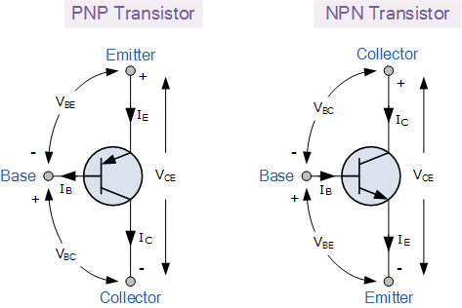
3. transistor
The BJT
The device has 3 terminals, base, collector and emitter.
The base is also called the control electrode.
It has 2 PN junctions, 3 junction voltages namely; Vbe, Vbc,Vce
It also has 3 terminal currents, base current, emitter current and the collector current

Slide 7
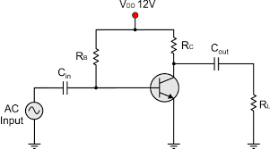
3.The fixed bias amp
This circuit can be used as an amplifier only if the base emitter junction is forward biased and the base collector junction is reversed biased.
The problem with this amp is that it tends to be saturated, this a condition where the amplifier does no longer amplifies.
To ensure that the transistor works as a linear amplifier, the base collector junction must be reversed biased thoroughly.
The base and collector resistors must be calculated in such a way that the transistor never enters the saturated region, this means that, Vce must always be greater than Vbe.
The bias of this circuit is dependant on the current gain.

Slide 8
Stabilization of a fixed bias
The fixed bias amp is unstable and this will cause a significant change in collector current as the temperature changes.
The collector current will vary with change in temperature because of the following factors:
  Inverse saturating current/ leakage current which doubles for each 10° increase in temperature
  Base emitter voltage which decreases with 2.5mV/deg
  Current gain which increases with temperature
A change in the collector current causes a shift in the work point/ Q-point
To prevent this shift
Emitter resistor is added between the emitter and ground.
    This resistor limits the collector current during an increase in temperature.
Emitter capacitor is added in shunt with the emitter resistor.
    This capacitor shorts circuits the AC component accumulating around the transistor.

Slide 9
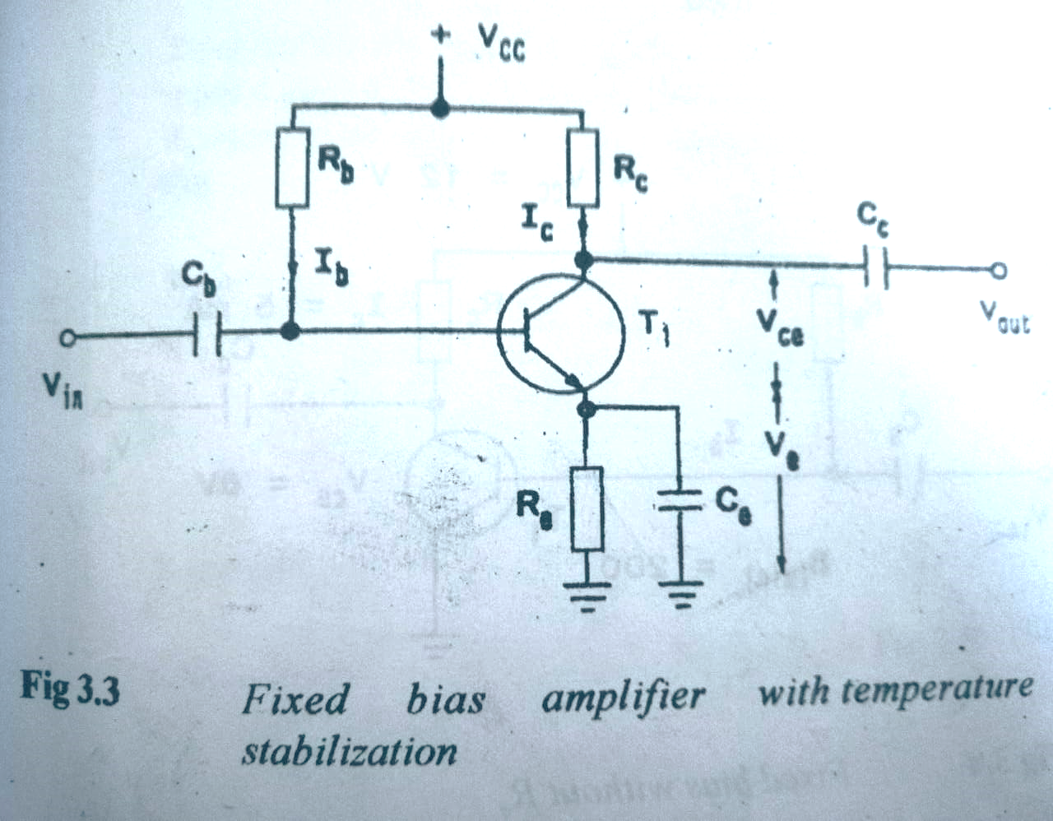
3.The fixed bias amp with temperature stabilization

Slide 10
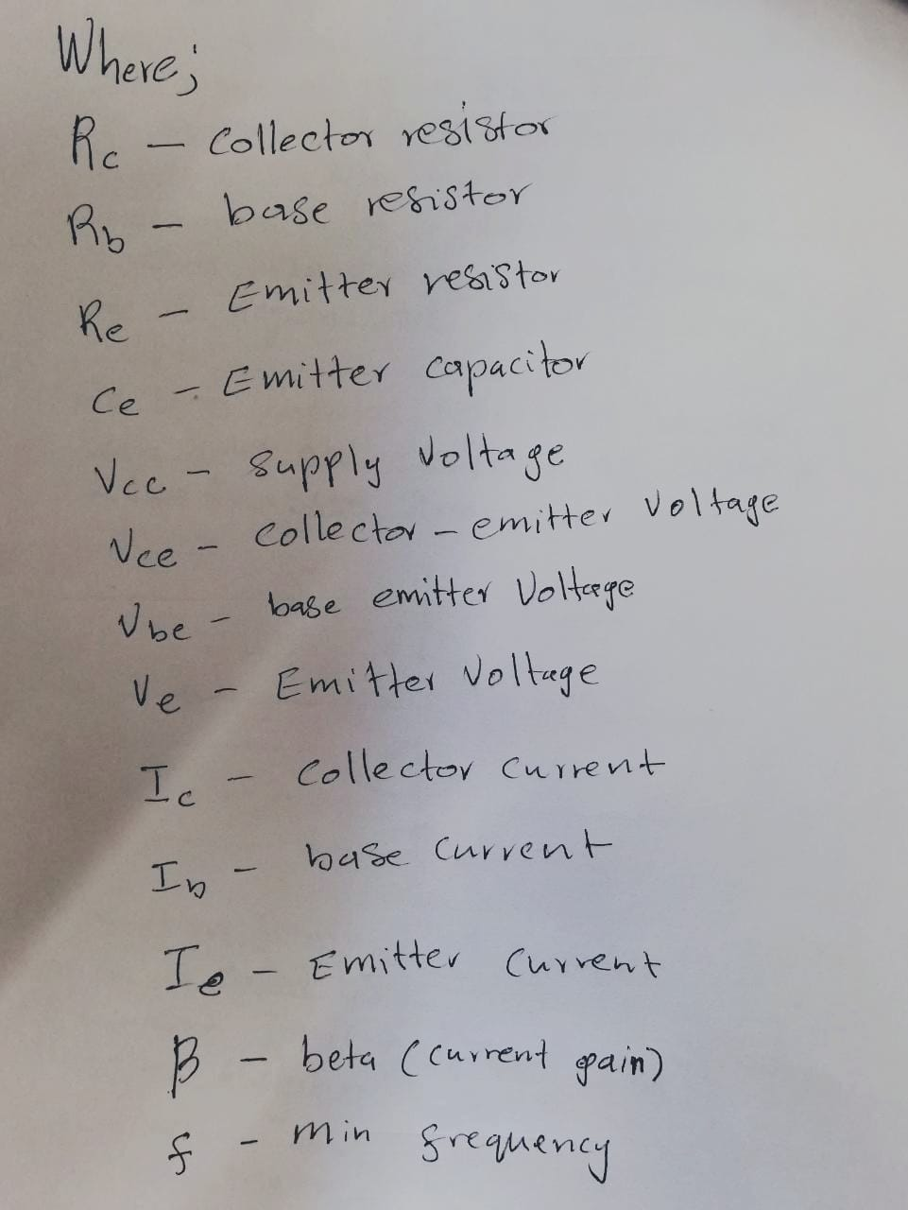
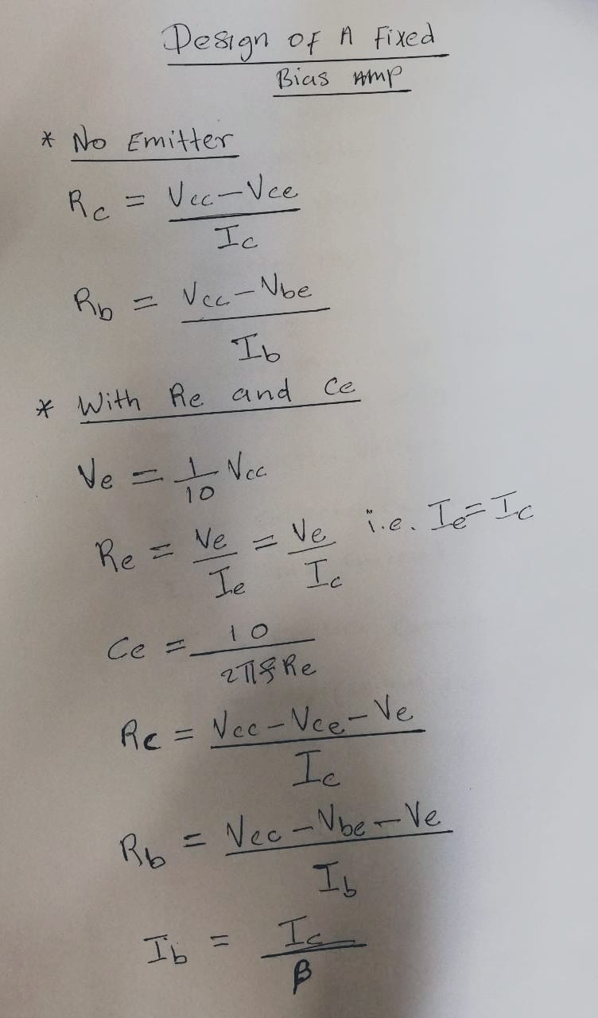
3.Design of a fixed bias amp

Slide 11
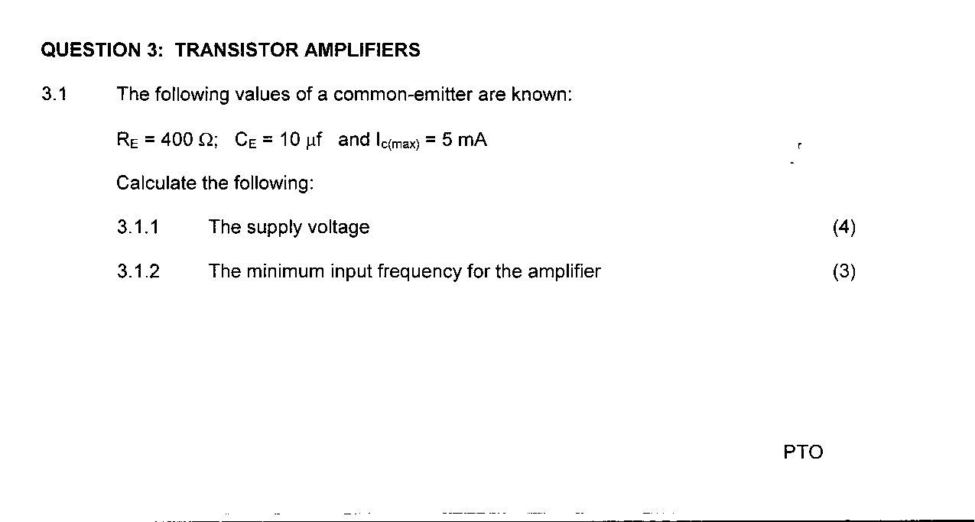
4. Activity 1

Slide 12
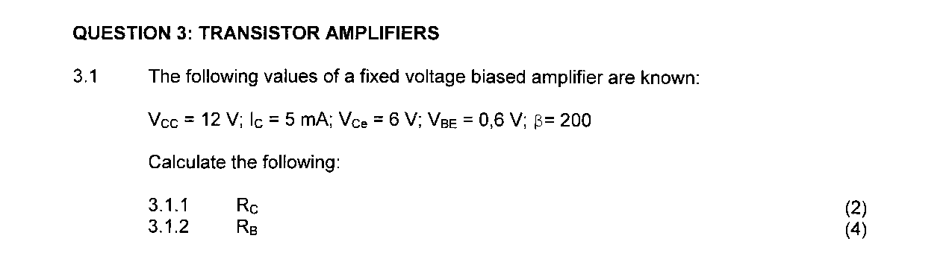
Activity 2

Slide 13
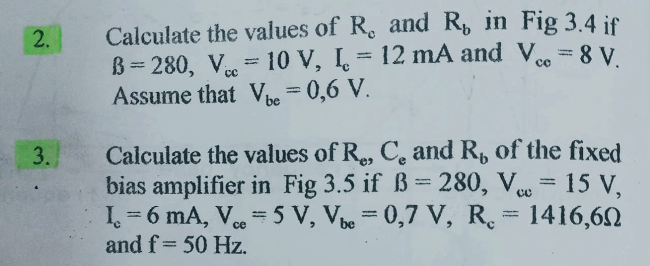
exercise

Slide 14
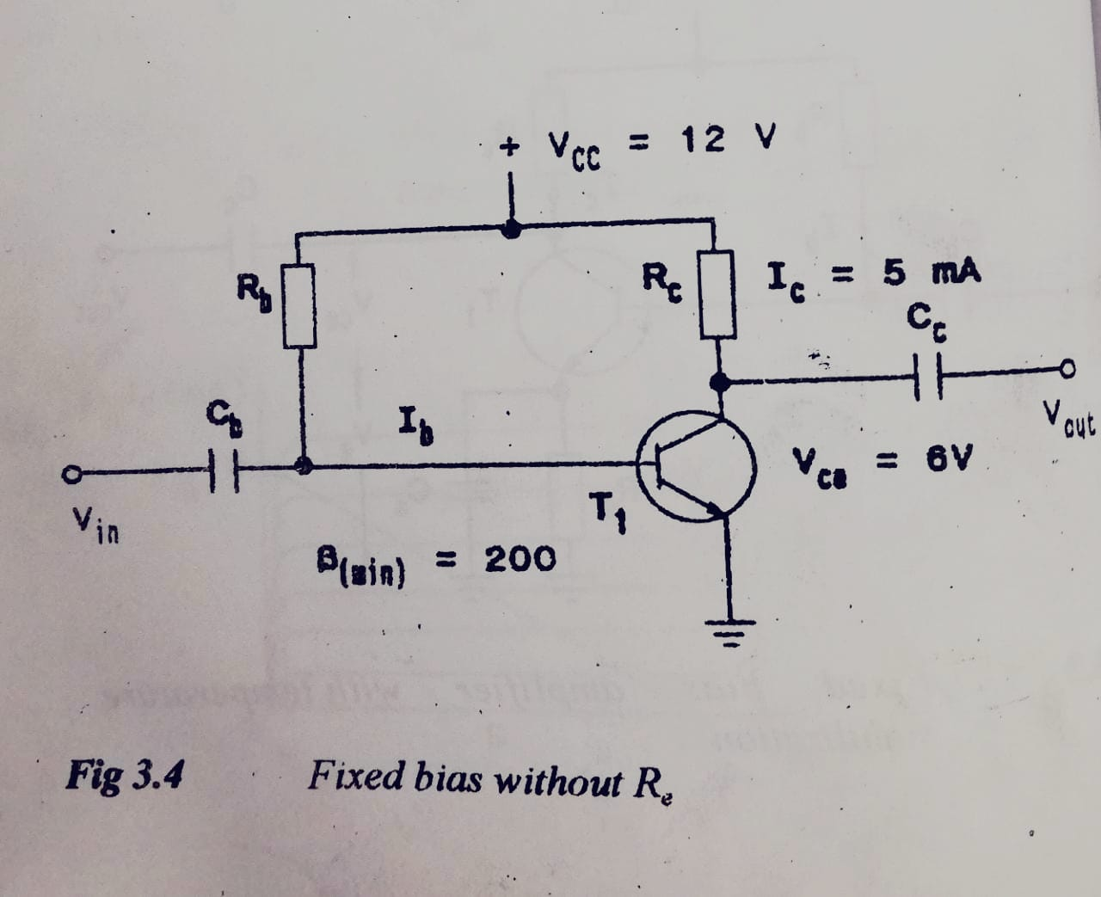

Slide 15
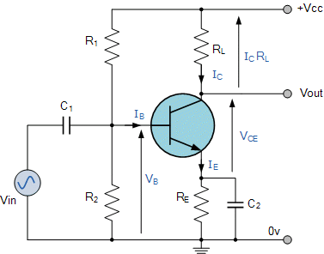
2. The potential divider
In a fixed bias amp, the values of the bias current and voltage is dependant on the current gain of the transistor. Meaning that if the current gain changes, the collector current also changes.
Because the current gain is temperature sensitive it is necessary to supply to supply a DC bias circuit which is not dependent of the current gain.
This type of circuit uses a voltage divider network with Rb1 and Rb2 or R1 and R2

Slide 16
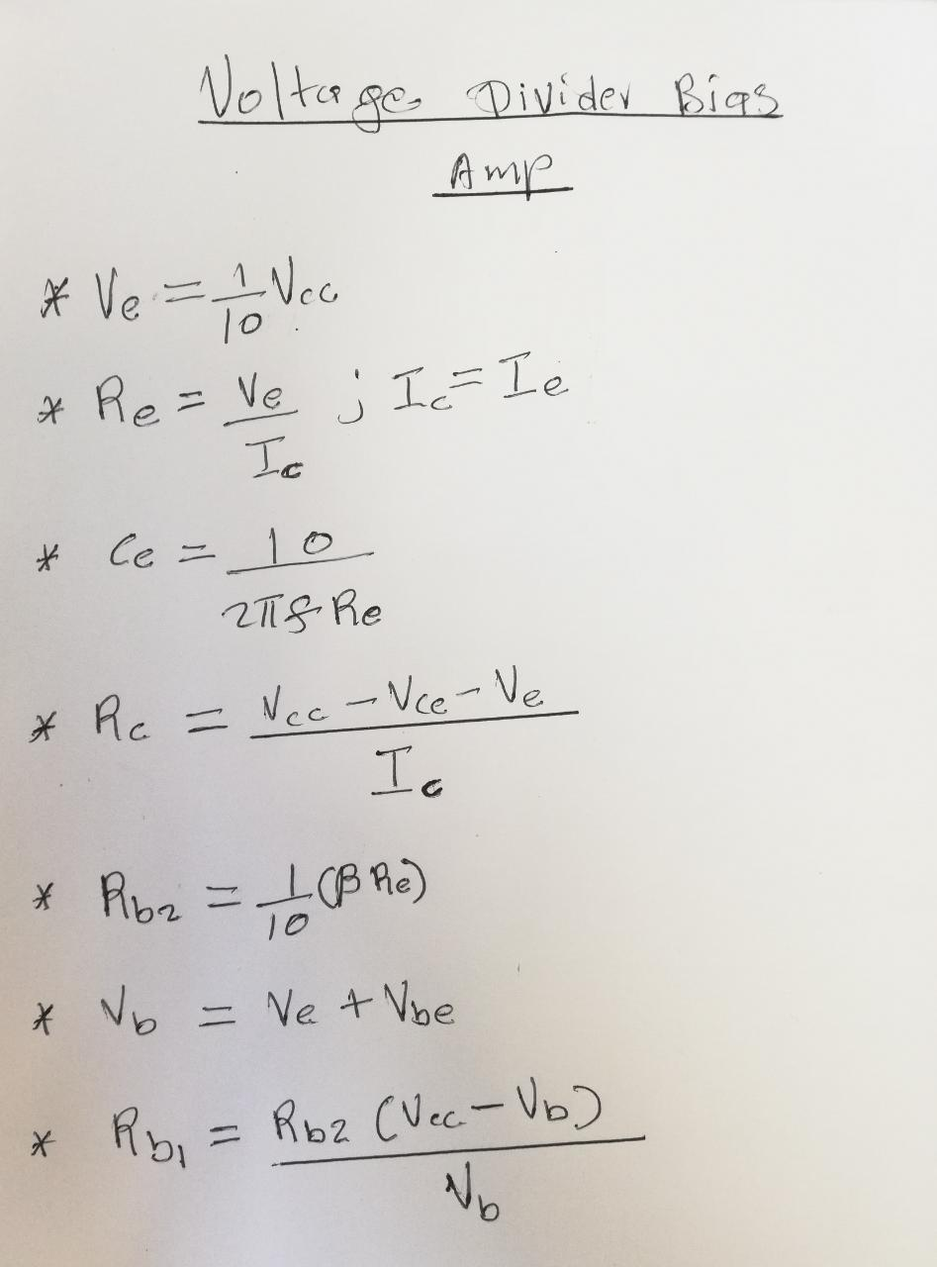
A. Concept
To design a potential divider amp, the following must apply

Slide 17
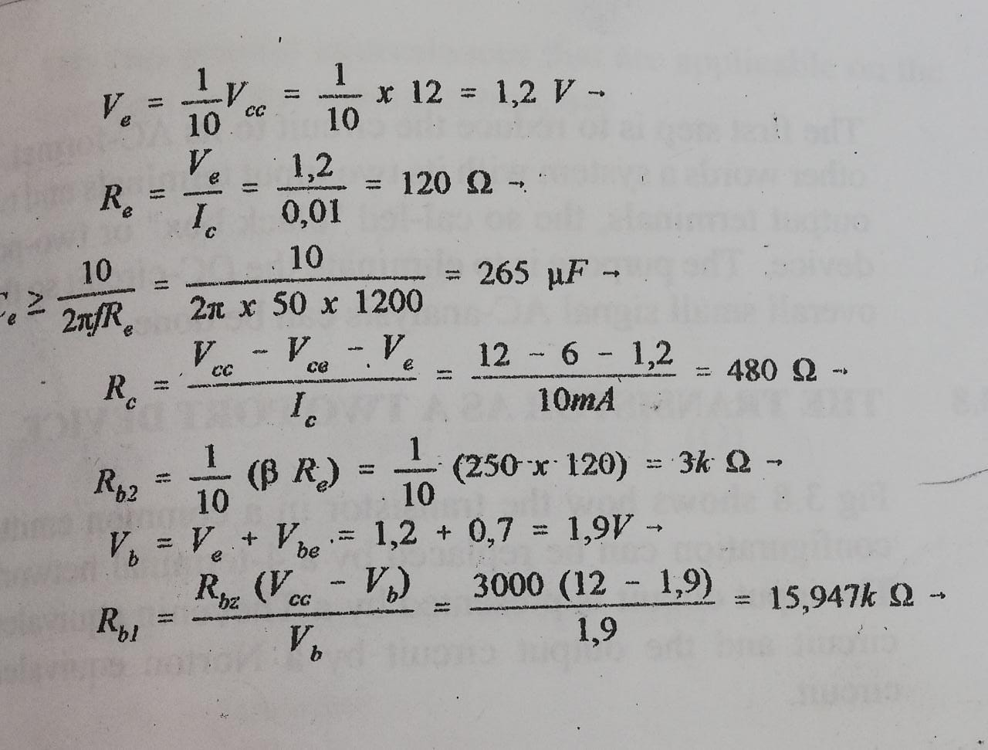
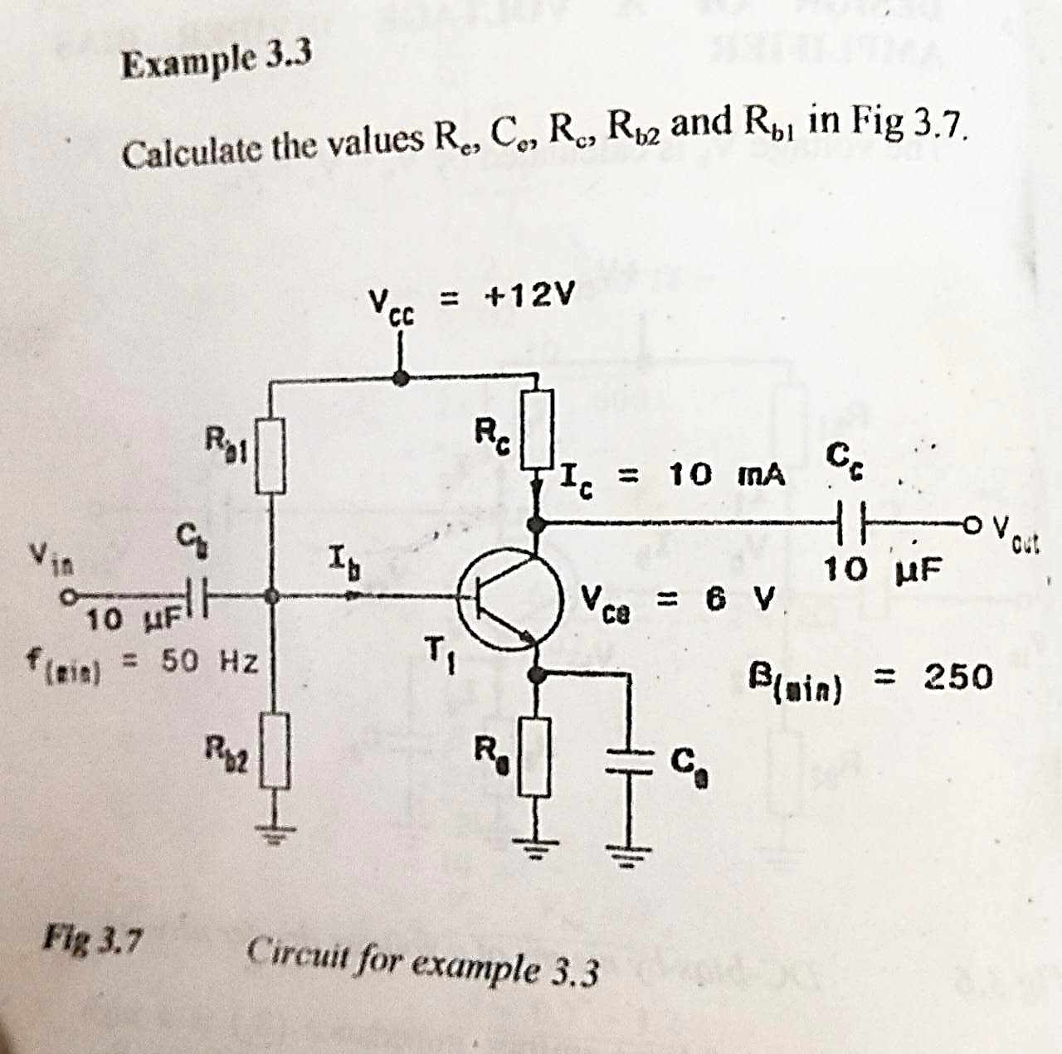
example

Slide 18
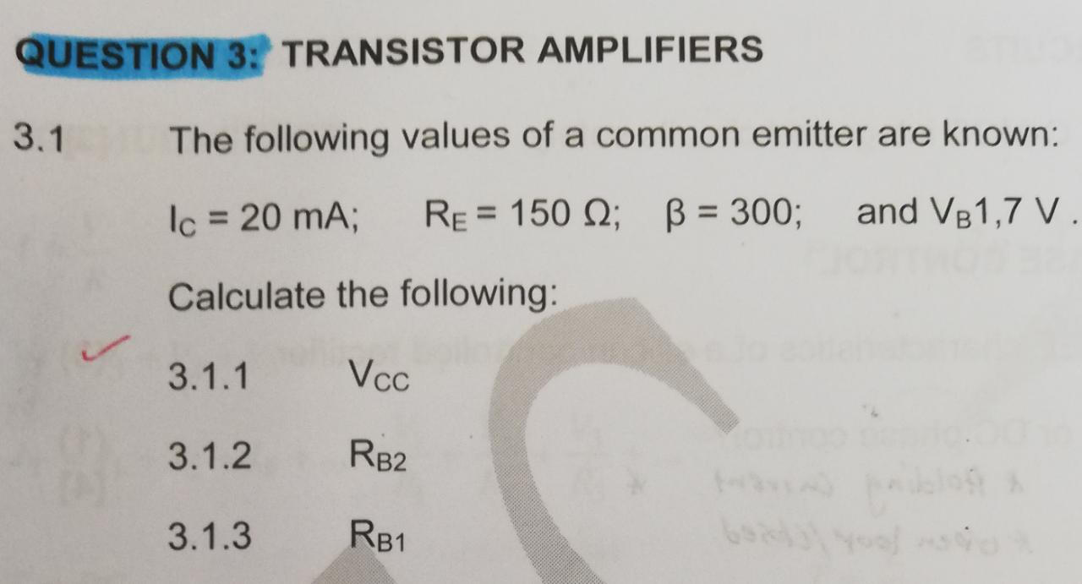
Exercise 1

Slide 19
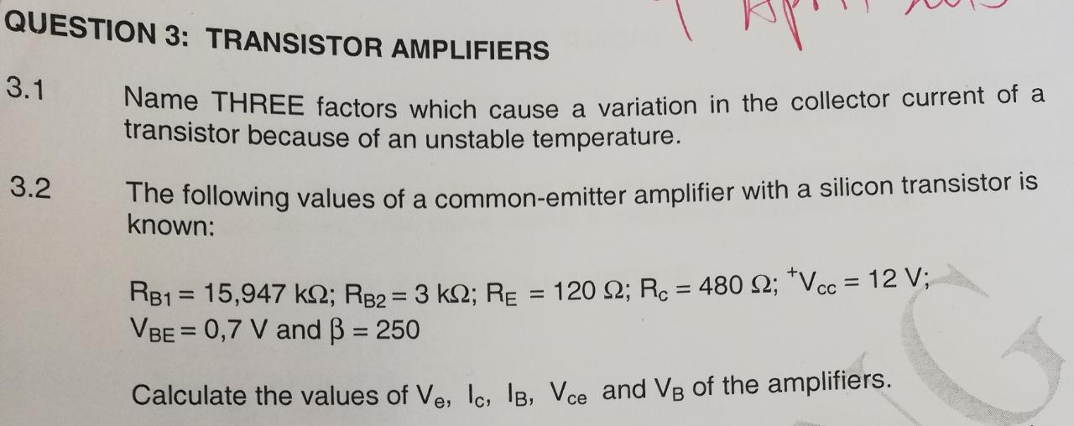
Exercise 2

Slide 20
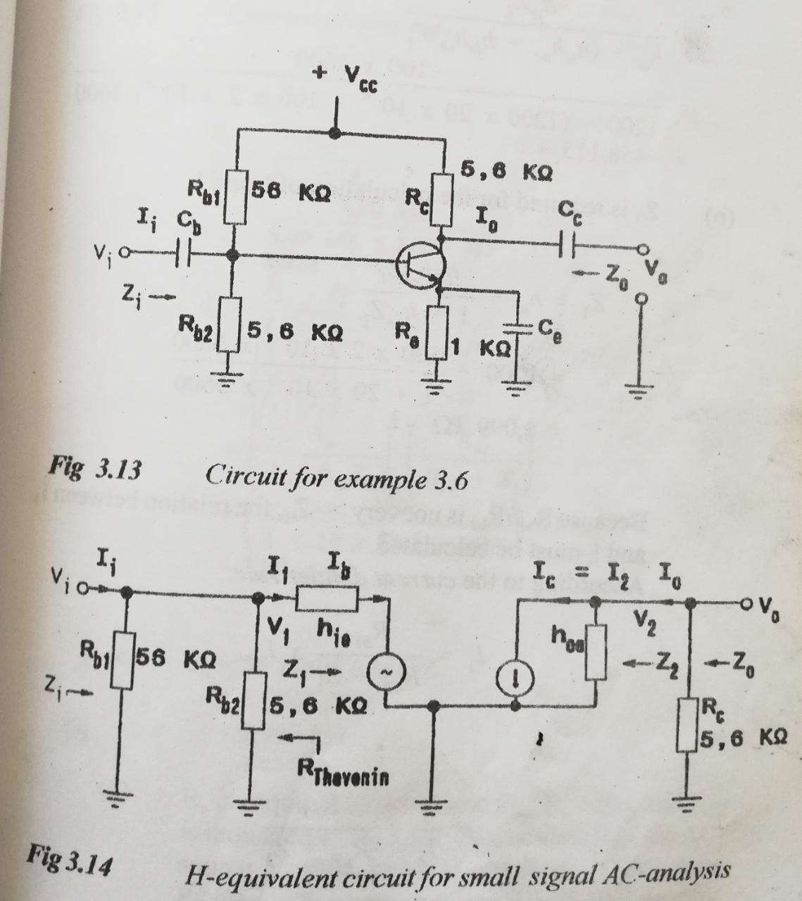
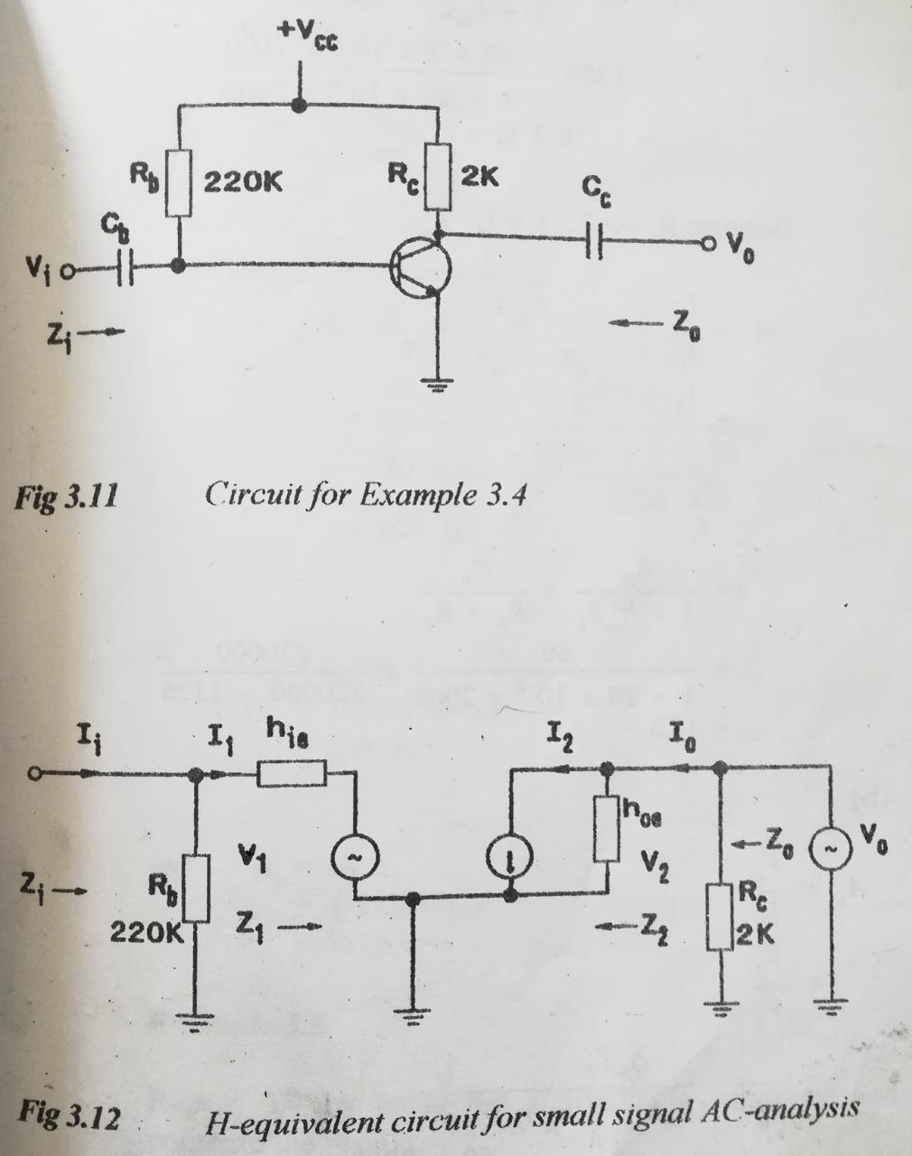
H-equivalent circuits

Slide 21
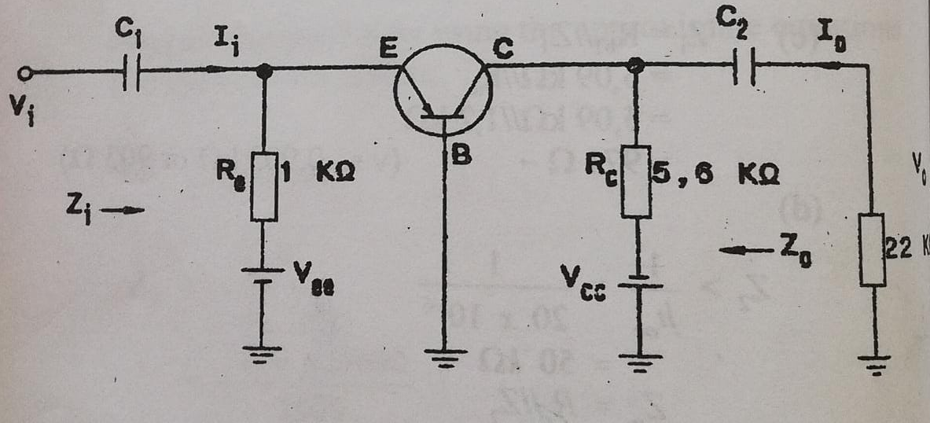
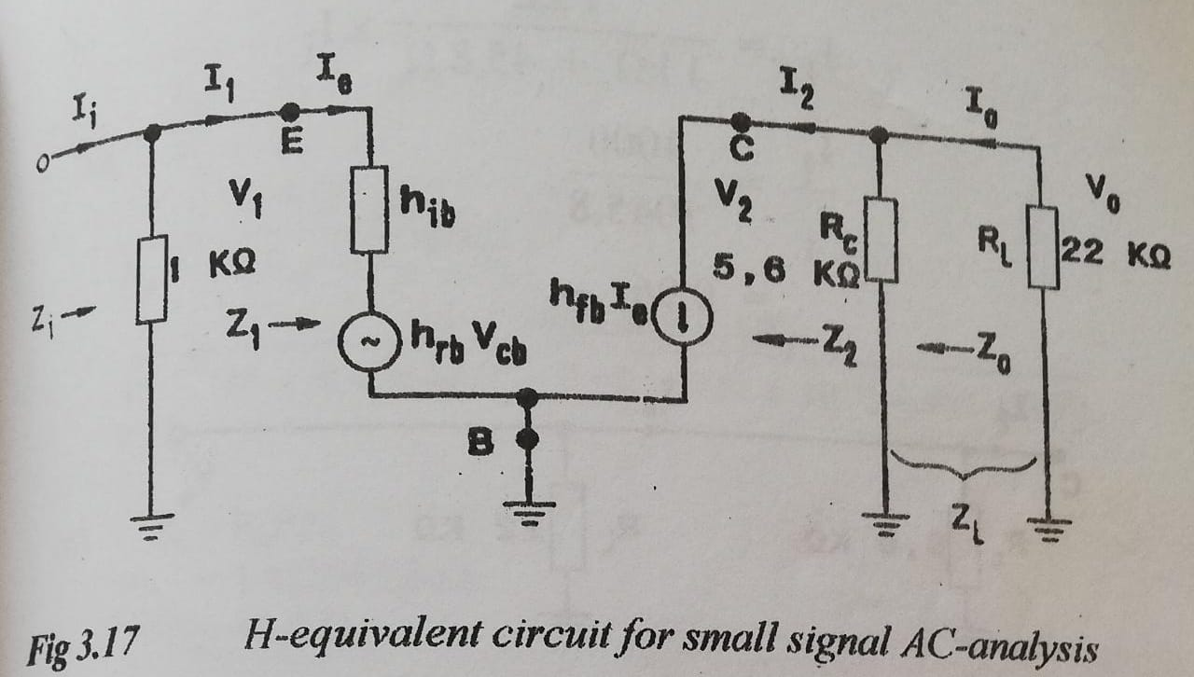

Slide 22
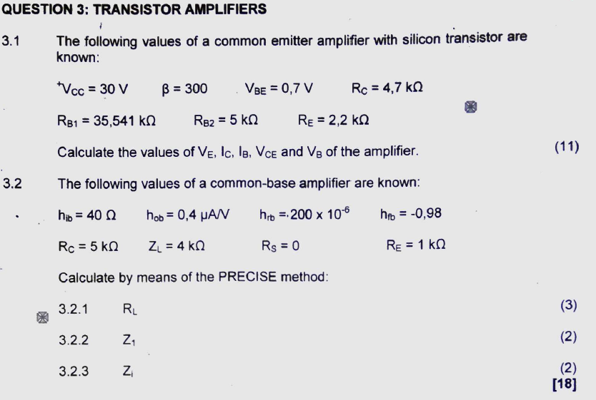
Example

Slide 23
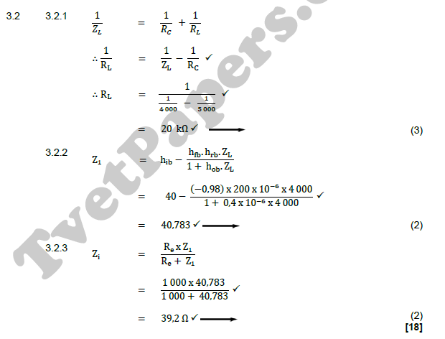
Solution

Slide 24
